Slide 1
Project Details :-
Project Name :- AI Chatbot Assistance
Objective :- Build an intelligent conversational agent leveraging LLMs and Python .
Repository link :- https://github.com/lokarepreethi2-code/-AI-chatbot-assistance-.git
Core Tech :- Python, Large Language Models (LLMs), Git/GitHub.

Slide 2
Project Name :- Chatbot AI Development
Group No. :- Group 3
Project No. :- Project 1 chatbot AI development
Group Details :-
--- Preethi Sanjay Lokare

Slide 3
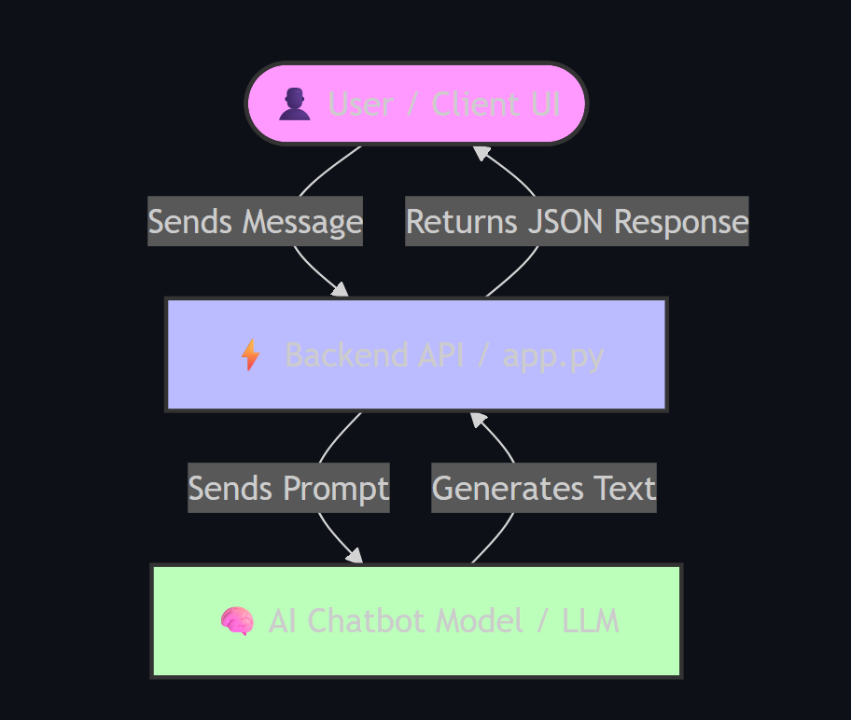
Project Architecture Diagram : -

Slide 4
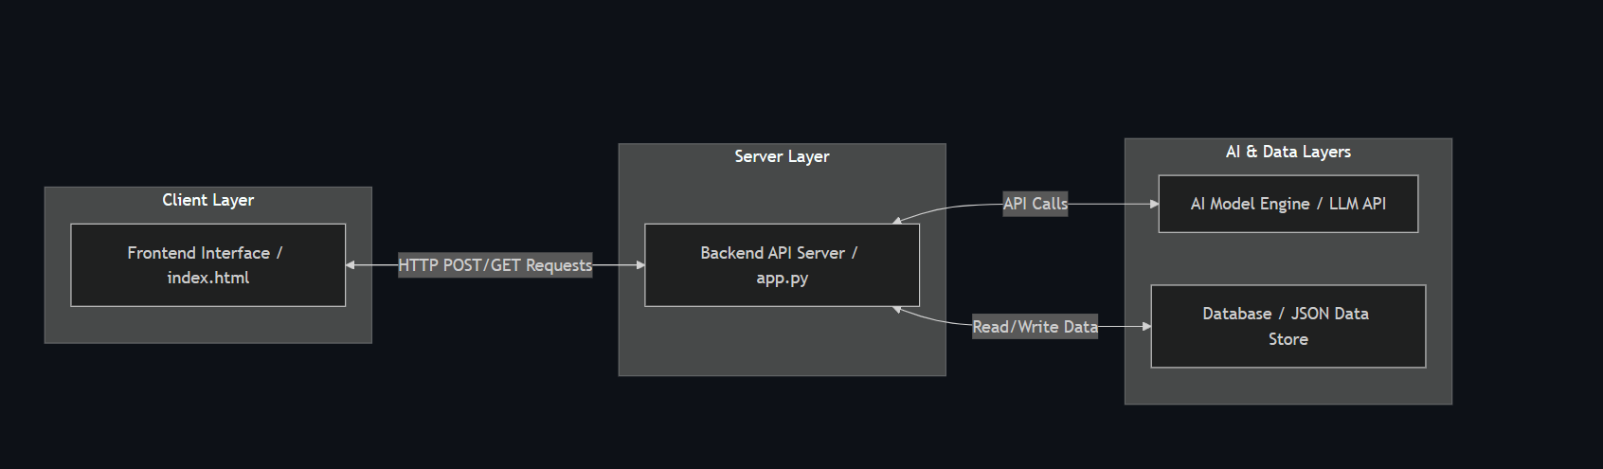
System Architecture :-

Slide 5
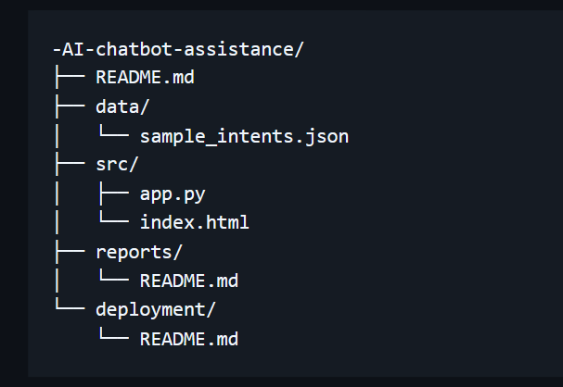
Git Hub Directory Structure :-
--- Thank you

